Slide 1
How to do faster template match
Lin Gao-Yuan
Spring 2012, Machine Vision
National Taiwan Normal University

Slide 2
Outline大綱

Slide 3
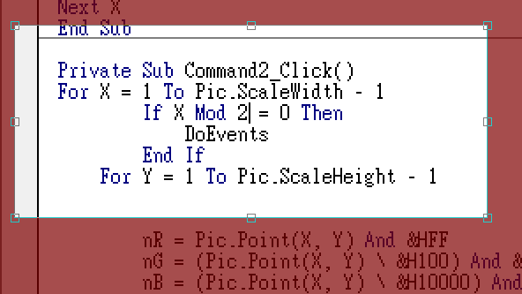
Skip!
Don‘t need to do “DoEvents” every pixels

Slide 4
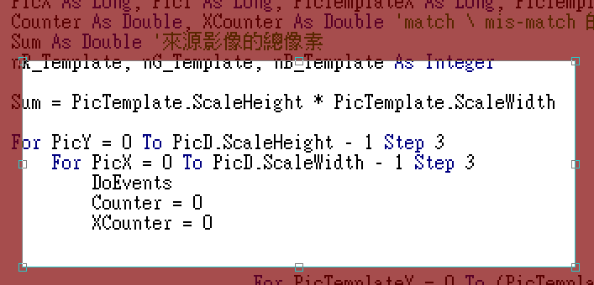
Just skip!
Don’t need to do template matching every(?) pixel
Speed up to 3*3=9X！

Slide 5
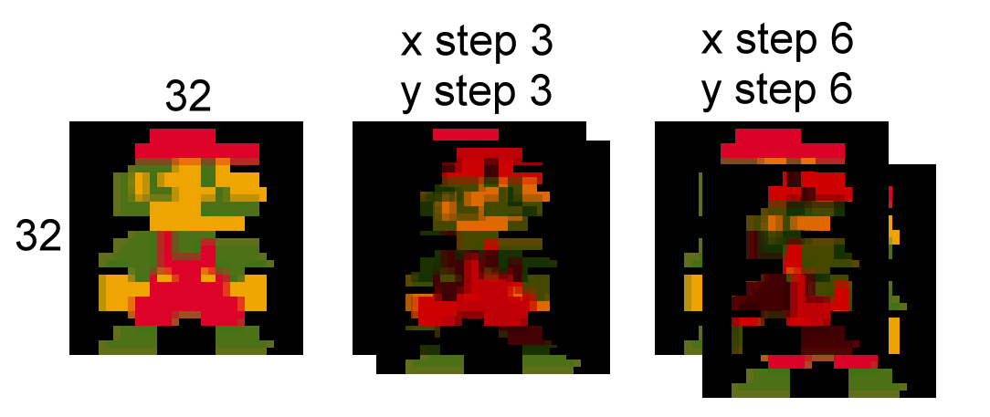
But don’t skip too much…

Slide 6
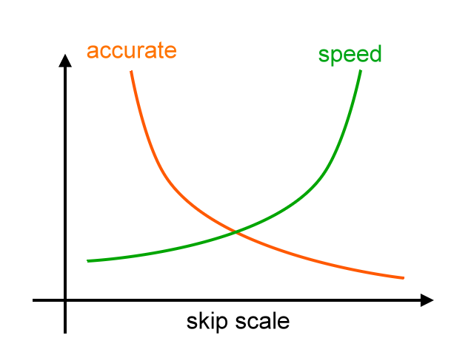
How to decide best skip scale ?
What is the best solution?

Slide 7
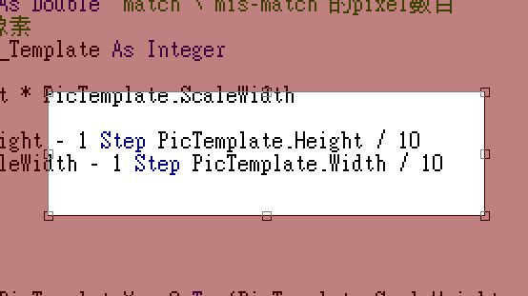
How to decide best skip scale ?
Decide to skip scale depending on template scale

Slide 8
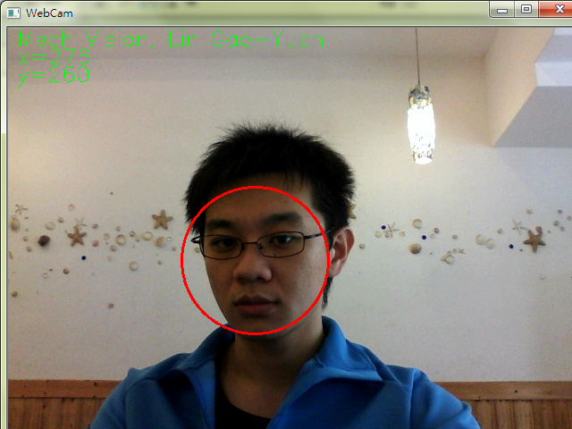
How to faster template match in video?
Process template match in video, which is very heavy and slow.
,because video has 24 frame per seconds.

Slide 9
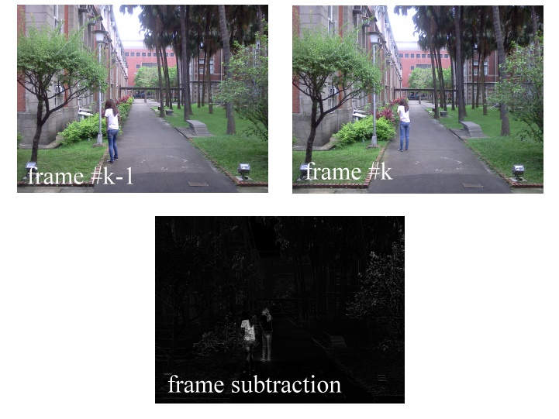
How to faster template match in video?

Slide 10
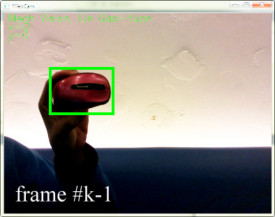
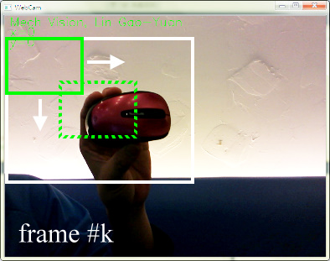
How to faster template match in video?
Depend on
frame#k-1’s match result, thus narrow template match range.

Slide 11
References
彭國軒(2003)。快速物件辨認與定位–環狀樣板比對。國力清華大學動力機械工程學系碩士論文
陳佩穎(1993)。以新型動態輪廓技術完成可追蹤任意形狀物體之強健影像伺服系統。國立台灣大學電機系碩士論文

